Slide 1
Dynamic Linkers Are the Narrow Waist of Operating Systems
PLOS’23
Charly Castes
Adrien Ghosn

Slide 2
The dynamic linker needs some love

Slide 3
How do we load programs?
execve
Elf
application
User Space
Kernel Space

Slide 4
How do we load programs?
execve
libm.so
libc.so
The dynamic linker interposes on all dynamic program instantiation
Elf
uses .so
ld.so
application
User Space
Kernel Space
Static
Dynamic

Slide 5
Dynamic programs are the norm
99% of ubuntu executables are dynamic programs

Slide 7
Why should we care?

Slide 8
Here is why I care
Software Isolated Processes
My toy kernel™

Slide 9
Here is why I care
Software Isolated Processes
Strongly typed Interfaces
My toy kernel™

Slide 10
Here is why I care
Software Isolated Processes
Strongly typed Interfaces
Unix processes, with sandboxing
My toy kernel™

Slide 11
Here is why I care
Software Isolated Processes
Strongly typed Interfaces
Unix processes, with sandboxing
Enclaves?
My toy kernel™

Slide 12
There was only two problems:
Implementing all of this will take me forever
No one will ever use my system

Slide 13
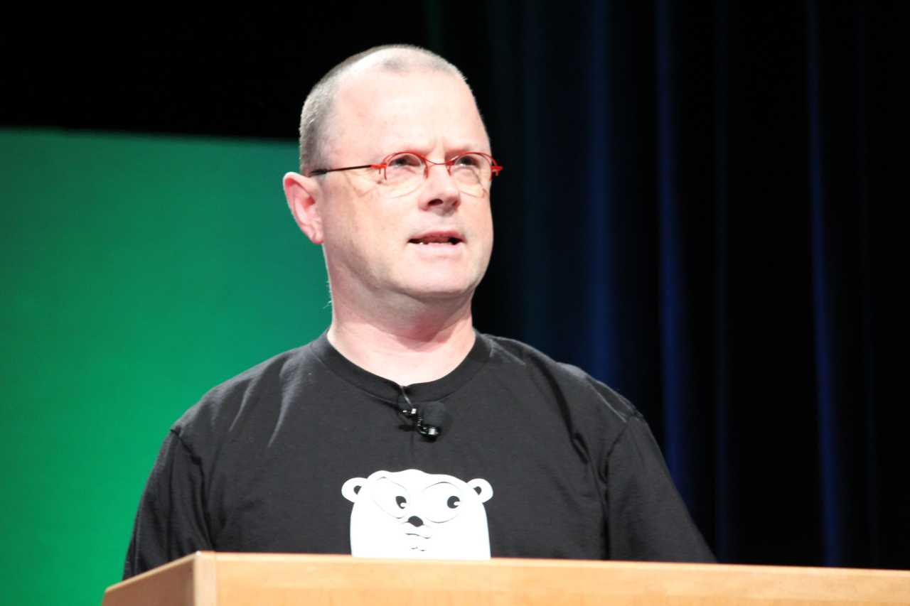
Systems Software Research is Irrelevant
Systems software research has become a sideline to the excitement in the computing industry.
Rob Pike - Feb 21, 2000

Slide 14
But what if I could implement my system on Linux, and keep all the existing programs?
Then maybe people would use it…

Slide 15
✨ Dynamic Linker ✨

Slide 16
Using the dynamic linker
Wasm Runtime
execve
Dynamic Linker
Linux

Slide 17
Using the dynamic linker
Wasm Runtime
execve
Unix
Dynamic Linker
Linux

Slide 18
Using the dynamic linker
Enclave
Qemu
Wasm Runtime
Unix
Browser
Dynamic Linker
Linux

Slide 19
One more example

Slide 20
Scaling seccomp filters
Seccomp is a mechanism to filter system calls
Application
Syscalls
Linux

Slide 21
Scaling seccomp filters
Extensive research to create good seccomp filters, but:
Expensive whole program analysis
Have to re-compute all filters when a library change
libc
libssl
Can we make seccomp filters scale to a whole distribution?
libm
Application
libqt

Slide 22
Scaling seccomp filters
We can compute per-library filters, and combine them transparently!
libc
libssl
Application
libm
libqt

Slide 23
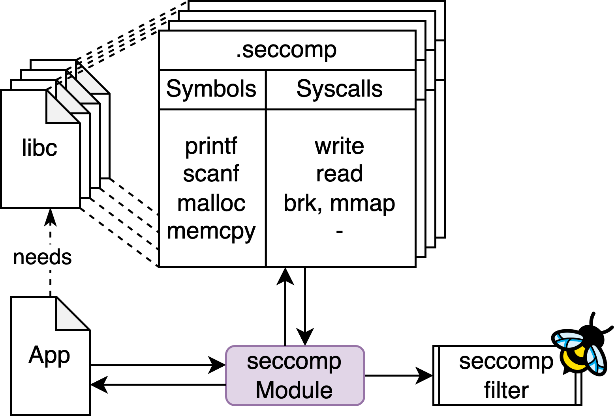
Example: Scaling seccomp filters

Slide 24
The dynamic linker is a narrow waist
And we can leverage it to evolve our systems

Slide 25
Conclusion
60,000+ packages
30,000,000+ LoC
ld2.so
ld.so
ld3.so
Or we can change this
And even add more

